Slide 1
— Preventing Abuse In Detention
An Expert Symposium on Independent
Monitoring within the OPCAT Framework
Notes:
To create Em dash above headline:
Same size and weight as the headline and set using a soft return.
PC: Em dash (—): Alt+Ctrl+ - (minus)
Mac: Em dash (—): Shift+Alt/Option+hyphen

Slide 2
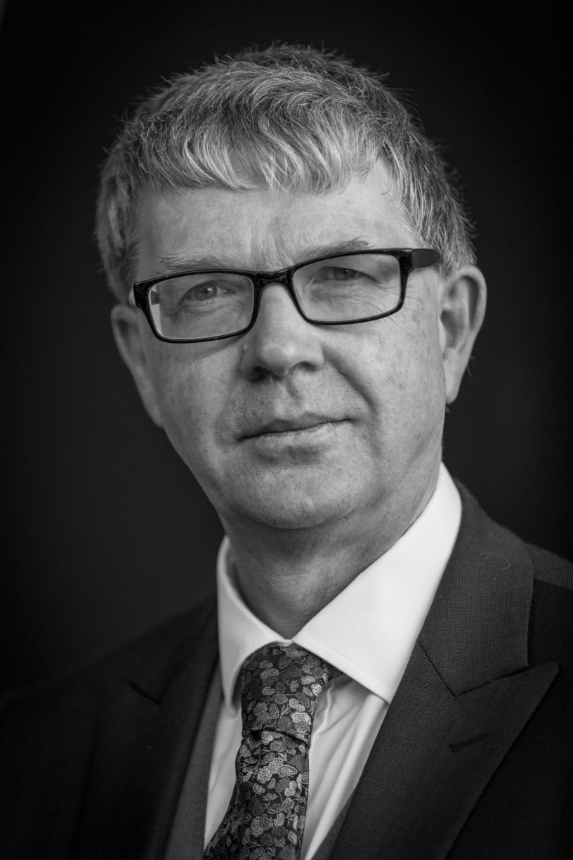
Professor Sir Malcolm Evans Chair, Subcommittee for the Prevention of Torture
Sir Malcolm Evans is a member and Chair of the UN Subcommittee for the Prevention of Torture (the SPT) and, from 2014-2015 Chair of the Meeting of Chairs of UN Human Rights Treaty Bodies. He is also a member of the UK Foreign Secretary’s Human Rights Advisory Group.

Slide 3
Professor Sir Malcolm Evans Chair, Subcommittee for the Prevention of Torture
Q: Tell us about your role and what your work on torture prevention entails

Slide 4
Professor Sir Malcolm Evans Chair, Subcommittee for the Prevention of Torture
Q: Based on your work with the SPT, could you tell us whether the OPCAT has the potential to make a difference in Australia and how?

Slide 5
Professor Sir Malcolm Evans Chair, Subcommittee for the Prevention of Torture
Q: You mentioned civil society and many of the participants who are here in the symposium today are members of civil society and NGOs. Does OPCAT provide any opportunities for their engagement with the oversight of places of detention?

Slide 6
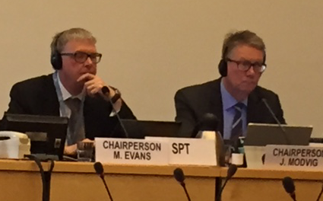
Professor Sir Malcolm Evans Chair, Subcommittee for the Prevention of Torture
Q: It seems like building support and engagement amongst civil society is important. What are some of the challenges we should be mindful of here in Australia as we move towards implementation?

Slide 7
Professor Sir Malcolm Evans Chair, Subcommittee for the Prevention of Torture
Q: Are there other political institutional factors which support effective implementation?

Slide 8
— Preventing Abuse In Detention
An Expert Symposium on Independent
Monitoring within the OPCAT Framework
Notes:
To create Em dash above headline:
Same size and weight as the headline and set using a soft return.
PC: Em dash (—): Alt+Ctrl+ - (minus)
Mac: Em dash (—): Shift+Alt/Option+hyphen

